Slide 1
Operating Systems CS2006
Chapter:3
Inter-Process Communication (IPC)
Part:2

Slide 2
Overview

Slide 3
Zombie Vs Orphan
1- Re-aping a process
When a parent process (waits) and then removes a child process's PCB (Process Control Block) after the child exits, freeing its resources and fully terminating it.
“Check child process state by using sleep(100) call.”
2- Reparenting a process
Happens when the parent process of a child terminates before the child does. The orphaned process is typically reparented to the init process (PID 1 in Linux) to ensure it has proper process management.

Slide 4
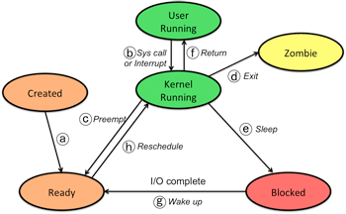
Process states: more detail

Slide 5
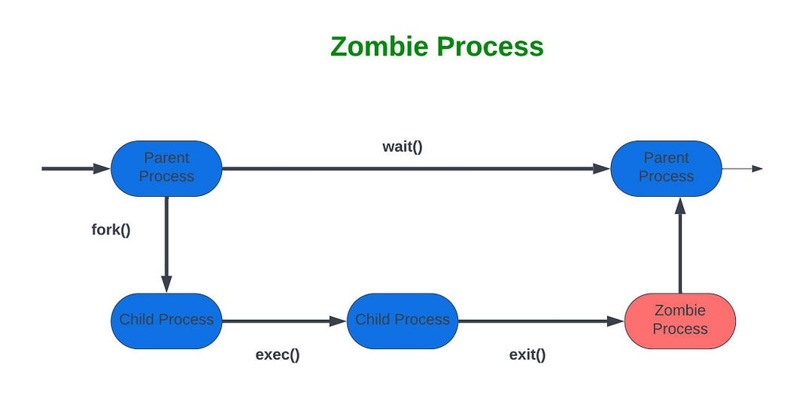
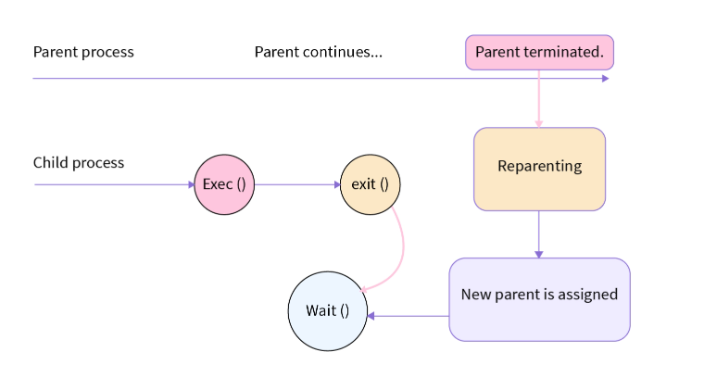
Orphan Process

Slide 6
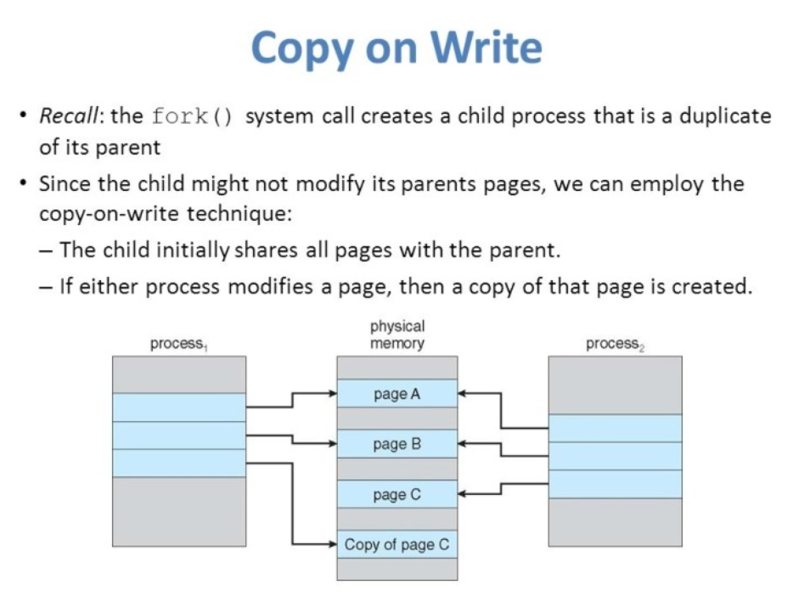

Slide 7
What’s in today’s lecture
Process Concept
Process Manager Responsibilities
Process Scheduling
Operations on Processes
Cooperating Processes
Inter-process Communication

Slide 8
Introduction
A process has access to the memory which constitutes its own address space.
When a child process is created, the only way to communicate between a parent and a child process is:
 The parent receives the exit status of the child
So far, we’ve discussed communication mechanisms only during process creation/termination
Processes may need to communicate during their life time.

Slide 9
Cooperating Processes
Independent process cannot affect or be affected by the execution of another process.
Cooperating process can affect or be affected by the execution of another process
Advantages of process cooperation
  Information sharing
  Computation speed-up
  Modularity
  Convenience
Dangers of process cooperation
  Data corruption, deadlocks, increased complexity
  Requires processes to synchronize their processing

Slide 10
Inter-Process Communication (IPC)
Mechanism for processes synchronize their actions.
Two main types
  Shared Memory
  Message Passing
to communicate and to

Slide 11








Communications Models
(a) Message passing. (b) shared memory.

Slide 12
Interprocess Communication – Shared Memory
An area of memory shared among the processes that wish to communicate
The communication is under the control of the users processes not the operating system.
Major issues is to provide mechanism that will allow the user processes to synchronize their actions when they access shared memory.
Synchronization is discussed in great details in Chapter 6.

Slide 13
Producer-Consumer Problem
Paradigm for cooperating processes, producer process produces information that is consumed by a consumer process
To allow producer and consumer processes to run concurrently, we must have available a buffer of items that can be filled by the producer and emptied by the consumer.
This buffer will reside in a region of memory that is shared by the producer and consumer processes.
A producer can produce one item while the consumer is consuming another item.
The producer and consumer must be synchronized, so that the consumer does not try to consume an item that has not yet been produced.

Slide 14
Producer-Consumer Problem
Two types of buffers can be used.
unbounded-buffer places no practical limit on the size of the buffer
bounded-buffer assumes that there is a fixed buffer size
 Let’s look more closely at how the bounded buffer illustrates inter- process communication using shared memory….

Slide 15
Bounded-Buffer – Shared-Memory Solution
The following variables reside in a region of memory shared by the producer and consumer processes:
Shared data
#define BUFFER_SIZE 10 typedef struct {
. . .
} item;
item buffer[BUFFER_SIZE]; int in = 0;
int out = 0;
Lets code this….

Slide 16
Bounded-Buffer – Producer
item next_produced; while (true) {
/* produce an item in next produced */
while (((in + 1) % BUFFER_SIZE) == out) ;
/* buffer is full - do nothing */
buffer[in] = next_produced;
in = (in + 1) % BUFFER_SIZE;
}

Slide 17
Bounded Buffer – Consumer
item next_consumed; while (true) {
while (in == out);
/* buffer empty - do nothing */
next_consumed = buffer[out];
out = (out + 1) % BUFFER_SIZE;
/* consume the item in next consumed */
}
■ This scheme allows at most BUFFER SIZE − 1 items in the buffer at the same time.

Slide 18
Message Passing (IPC)
Message system – processes communicate with each other without resorting to shared variables.
IPC facility provides two operations:
  send(message) – message size fixed or variable
  receive(message)
If P and Q wish to communicate, they need to:
  establish a communication link between them
  exchange messages via send/receive
Implementation of communication link
  physical (i.e., shared memory, hardware bus)
  logical (direct/indirect, blocking/non-blocking, automatic/ explicit buffering)

Slide 19
Implementation Questions
How are links established?
Can a link be associated with more than two processes?
How many links can there be between every pair of communicating processes?
What is the capacity of a link?
Is the size of a message that the link can accommodate fixed or variable?
Is a link unidirectional or bi-directional?

Slide 20
Message Passing Systems
Exchange messages over a communication link
Methods for implementing the communication link and primitives (send/receive):
  Direct or Indirect communications (Naming)
  Symmetric or Asymmetric communications (blocking versus non-blocking)
  Buffering

Slide 21
Direct Communication
Processes must name each other explicitly:
  send (P, message) – send a message to process P
  receive(Q, message) – receive a message from process Q
Properties of communication link
  Links are established automatically.
  A link is associated with exactly one pair of communicating processes.
  Between each pair there exists exactly one link.
  Processes need to know each other’s identity
  The link may be unidirectional, but is usually bi-directional.
Disadvantage: a process must know the name or ID of the process(es) it wishes to communicate with

Slide 22
Indirect Communication
Messages are directed and received from mailboxes (also referred to as ports).
  Each mailbox has a unique id.
  Processes can communicate only if they share a mailbox.
Properties of communication link
  Link established only if processes have a shared mailbox
  A link may be associated with many processes.
  Each pair of processes may share several communication links.
  Link may be unidirectional or bi-directional.

Slide 23
Indirect Communication (Cont.)
Operations provided by the OS
  create a new mailbox
  send and receive messages through mailbox
  destroy a mailbox
Primitives are defined as:
  send(A, message) – send a message to mailbox A
  receive(A, message) – receive a message from mailbox A

Slide 24
Indirect Communication (Cont.)
Mailbox sharing
  P1, P2, and P3 share mailbox A.
  P1, sends; P2 and P3 receive.
  Who gets the message?
Solutions
  Allow a link to be associated with at most two processes.
  Allow only one process at a time to execute a receive operation.
  Allow the system to select arbitrarily the receiver. Sender is notified who the receiver was.

Slide 25
Synchronization
Message passing can be blocking or non-blocking
Four types of synchronization
  Blocking send:
    sender blocked until message received by mailbox or process
  Nonblocking send:
    sender resumes operation immediately after sending
  Blocking receive:
    receiver blocks until a message is available
  Nonblocking receive:
    receiver returns immediately with either a valid or null message.
20

Slide 26
Produces Consumer
■ Producer-consumer becomes trivial
The producer merely invokes the blocking
message next_produced;
while (true) {
send() call and waits
/* produce an item in next produced */ _{until the message is}
send(next_produced);
}
delivered to either the receiver or the mailbox.
message next_consumed; while (true) {
receive(next_consumed);
Likewise, when the consumer invokes receive(), it blocks until a message is available.
/* consume the item in next consumed */
}

Slide 27
Buffering
Messages exchanged by processes reside in temporary queue
Three ways to implement queues
  Zero capacity
No messages may be queued within the link, requires sender to block until receiver retrieves message.
  Bounded capacity
Link has finite number of message buffers. If no buffers are available then sender must block until one is freed up.
  Unbounded capacity
Link has unlimited buffer space, consequently send never needs to block.

Slide 28
Communication in Client/Server Systems
Sockets
Remote procedure calls
Pipes
What types of Inter-Process Communication might each of these use?

Slide 29
1. Sockets
Defined as a point of communication
A pair of process communicating over a network employee a pair of sockets
Socket = IP Address : Port Number
All ports below 1024 are considered well known
  FTP: 21
  Telnet: 23
  Web server: 80
24

Slide 30
Sockets
Client initiates a requests for connection, it is assigned a port by host computer
Connection on one host must be unique
Sockets can be
  Connection-oriented (TCP) socket
  Connectionless (UDP) socket
Considered Low level mode of communication
  Shares unstructured stream of bytes

Slide 31
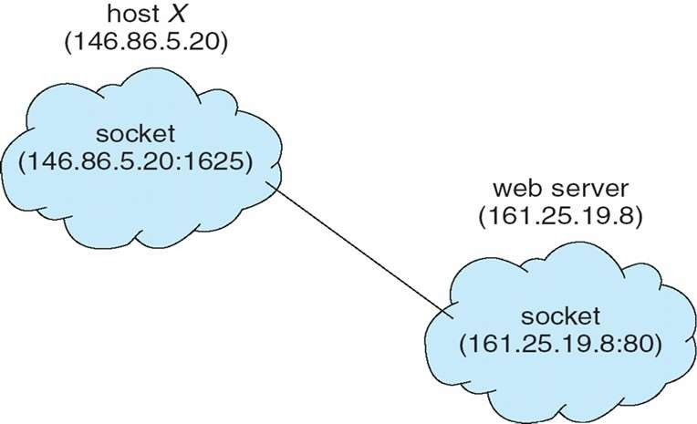
Sockets

Slide 32
2- RPC

Slide 33
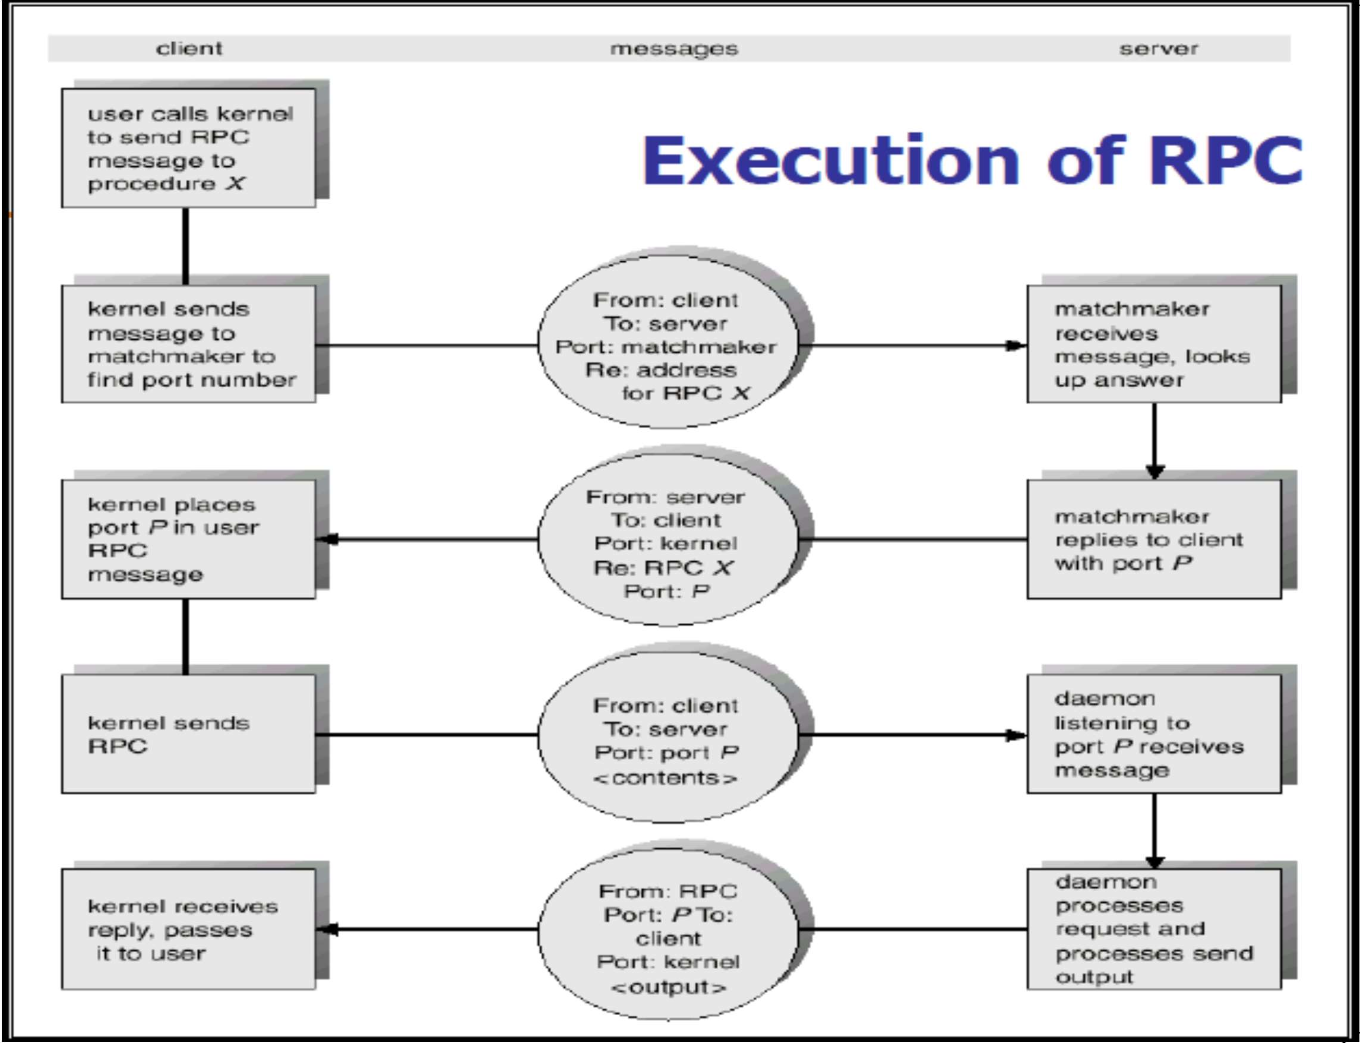
32
CS-2006 Operating Systems

Slide 34
3- PIPES

Slide 35
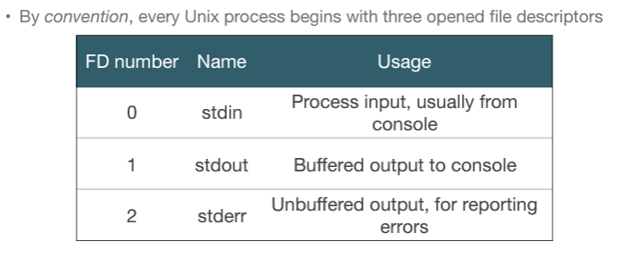
Default File Descriptors

Slide 36
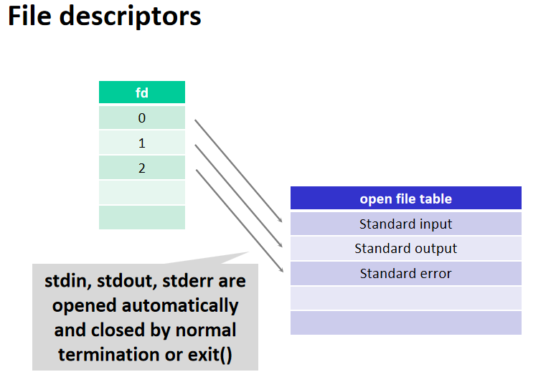

Slide 37
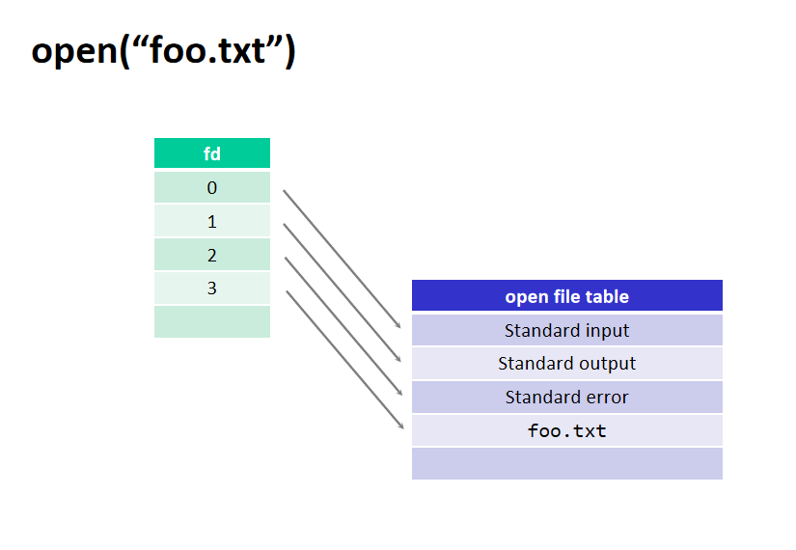

Slide 38
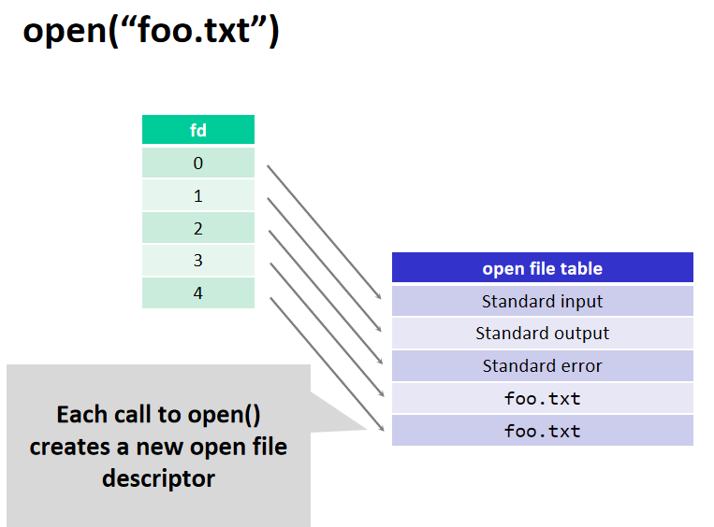

Slide 39
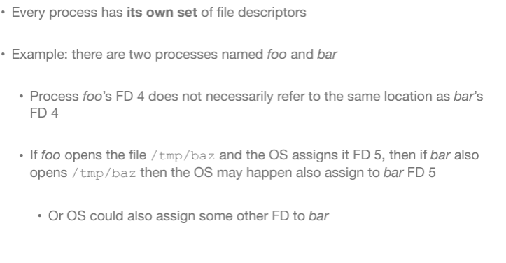
Sharing File Descriptors

Slide 40
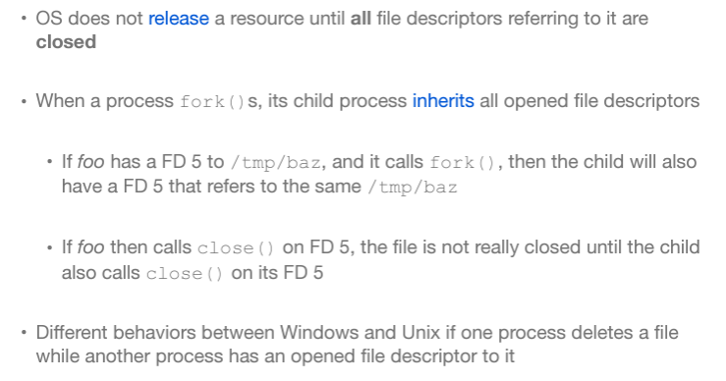
Duplicate File Descriptors

Slide 41
3. Pipes
IPC mechanism in early UNIX systems
Four issues must be considered
  Unidirectional or bi-directional communication
  If bidirectional then is it half duplex or full duplex
  Must a relationship (such as parent-child) exist between the communicating processes?
  Can pipe communicate over a network?
33
CS-2006 Operating Systems

Slide 42
Pipes: Shared info in kernel’s memory
Buffer in kernel’s memory
fd[0]
fd[1]
Pipe
write()
read()
34

Slide 43
Pipes
Two types of pipes
  Ordinary pipes
  Named pipes
  •Unnamed pipe: parent process creates pipe, then uses it to communicate with its child processes ,And they are temporary; they need to be created every time and are
  destroyed when the corresponding processes exit
  • Named pipe (FIFO): any two processes (potentially unrelated) can use

Slide 44
Ordinary pipes
Ordinary pipes allow communication in standard producer-consumer form
Producer writes to one end of the pipe (the write-end)
Consumer reads from other end of the pipe (the read- end of the pipe)
Ordinary pipes are therefore unidirectional
Required parent-child relationship communicating processes
In windows known as Anonymous pipes
between

Slide 45
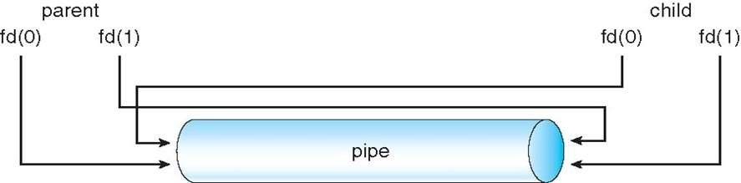
Ordinary pipe

Slide 46
Pipe Creation (Unix)
#include <unistd.h>
int pipe(int filedes[2]);
Creates a pair of file descriptors pointing to a pipe inode
Places them in the array pointed to by filedes
  filedes[0] is for reading
  filedes[1] is for writing.
On success, zero is returned.
On error, -1 is returned
35

Slide 47
Pipe Creation
int main()
{ int pfds[2];
if (pipe(pfds) == -1)
{ perror("pipe"); exit(1); }
pfds[0]
pfds[1]
}
Process Kernel
Pipe flow of data
CS-2006 Operating Systems
36

Slide 48
Reading/Writing from/to a Pipe
 int read(int filedescriptor, char
*buffer, int bytetoread);
 int write(int filedescriptor,char
*buffer,int bytetowrite);
37
CS-2006 Operating Systems

Slide 49
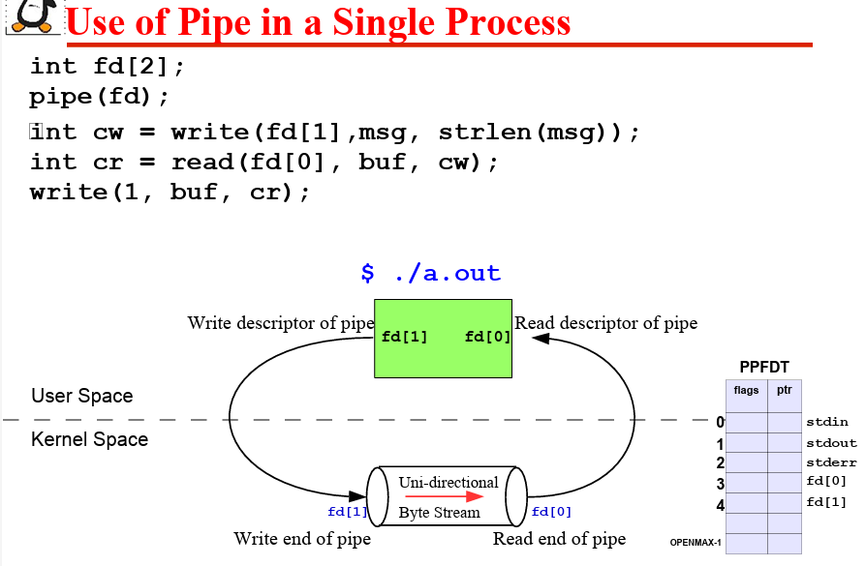

Slide 50
Example
int main()
{ int pfds[2]={0,1}; char buf[30];
if (pipe(pfds) == -1)
{
perror("pipe");
exit(1);
}
printf("writing to file descriptor #%d\n", pfds[1]);
write(pfds[1], "test", 5);
printf("reading from file descriptor #%d\n",pfds[0]);
read(pfds[0], buf, 5);
printf("read %s\n", buf);
}
write(pfds[1], "test", 5);

Slide 51
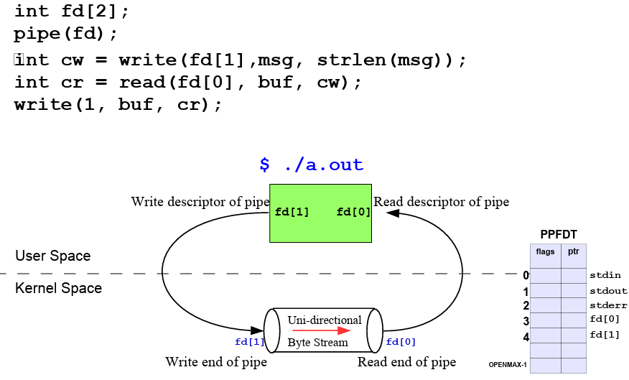
Use of Pipe in a Single Process

Slide 52
A Channel between two processes
Parent
Child
pfds[0]
pfds[1]
2. Fork()
pfds[0]
pfds[1]
1. Pipe()
Process
Kernel
Pipe flow of data

Slide 53
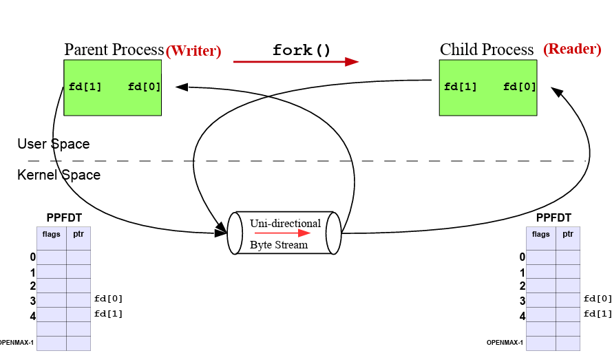
Use of Pipe Between two Related Processes

Slide 54
A Channel between two processes
To allow one way communication each process should close one end of the pipe.
Parent Child
2. Fork()
4. close(pfds[0]) pfds[0]
pfds[0]
pfds[1]
3. close(pfds[1])
pfds[1]
1. Pipe()
Process
Kernel
Pipe flow of data

Slide 55
An Example of pipes with fork
int main()
{
int pfds[2];
char buf[30]; pipe(pfds);…………………………………………1 if (fork()==0) ………………………………………2
{
close(pfds[0]);…………………………………3
printf(" CHILD: writing to the pipe\n");
write(pfds[1], "test", 5);
printf(" CHILD: exiting\n"); exit(0);
}
else {
wait(NULL);
close(pfds[1]);…………………………………………4
printf("PARENT: reading from pipe\n");
read(pfds[0], buf, 5);
printf( "PARENT: read \"%s\"\n", buf); }
} CS-2006 Operating Systems
41

Slide 56
2- Named pipes/ FIFO
Named pipes are more powerful than ordinary pipes
Communication is bidirectional
No parent-child relationship is necessary between the communicating processes
Several processes can use the named pipe for communication
Provided on both UNIX and Windows
Called FIFO in UNIX

Slide 57
Introduction to FIFOs
●Pipes have no names, and their biggest disadvantage is that they can be only used between processes that have a parent process in common (ignoring descriptor passing)
● UNIX FIFO is similar to a pipe, as it is a one way (half duplex) flow of data. But unlike pipes a FIFO has a path name associated with it allowing unrelated processes to access a single pipe
● FIFOs/named pipes are used for communication between related or unrelated processes executing on the same machine
● A FIFO is created by one process and can be opened by multiple processes for reading or writing. When processes are reading or writing data via FIFO, kernel passes all data internally without writing it to the file system. Thus a FIFO file has no contents on the file system; the file system entry merely serves as a reference point so that processes can access the pipe using a name in the file system

Slide 58
mkfifo() Library Call
int mkfifo(const char*pathname, mode_t mode);
● Makes a FIFO special file with name pathname. The second argument mode specifies the FIFO’s permissions.
● Once you have created a FIFO, any process can open it for reading or writing, in the same way as an ordinary file. Opening a FIFO for reading normally blocks until some other process opens the same FIFO for writing, and vice versa

Slide 59
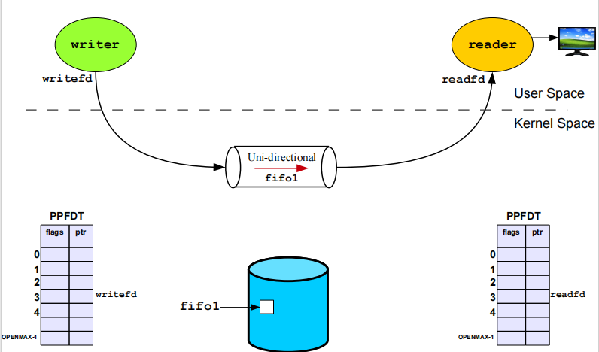
Communication Using FIFO

Slide 60
mkfifo command
Process1:
mkfifo mypipe
echo "Hello from Process 1" > mypipe
Process2:
cat < mypipe
"Hello from Process 1" will be get printed on output screen.

Slide 61
Step 1: Create a FIFO File
mkfifo myfifo
This creates a special file named myfifo that will be used for inter-process communication.
Process1: (Writer process)
char msg[] = "Hello from Writer!";
// Open FIFO in Write-Only mode
fd = open("myfifo", O_WRONLY);
write(fd, msg, strlen(msg) + 1);
Process2: (Reader process)
char buffer[100];
// Open FIFO in Read-Only mode
fd = open("myfifo", O_RDONLY);
read(fd, buffer, sizeof(buffer));
printf("Message received: %s\n", buffer);

Slide 62
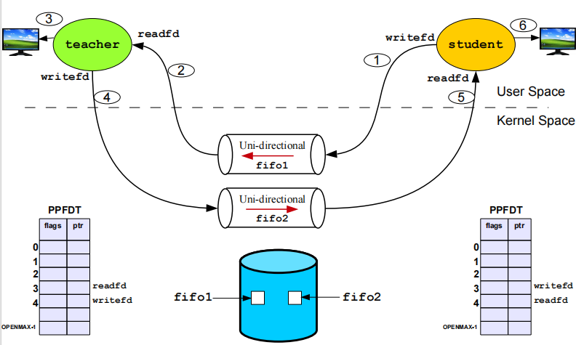
Bidirectional Comm Using FIFOs

Slide 63
References
 Operating System Concepts (Silberschatz, 9th edition) Chapter 3

